Slide 1

Prompt Engineering
22071A6759 - M.Tejaswi

Slide 2

INTRODUCTION
Prompt engineering is the process of structuring an instruction that can be interpreted and understood by a generative artificial intelligence (AI) model.
By carefully constructing prompts, users can unlock the true potential of these AI-powered tools to generate high-quality, tailored content.

Slide 3






Enhanced Control
Prompts give users the ability to steer the language model in the direction they desire, tailoring the output to meet specific requirements.
Significance of Prompts
Optimized Processes
Using well-constructed prompts can simplify and automate text generation tasks, leading to increased efficiency and productivity.
Unclocking Potential
Carefully crafted prompts enable language models to reach their maximum potential, producing more accurate and meaningful results.

Slide 4
1
Defined Goal
Begin with a clear and specific objective for what you want the language model to achieve.
Designing Powerful
Prompts
Detailed Guidance
2
Give precise instructions and set boundaries to direct the model's output effectively.
Relevant Context
3
Incorporate necessary background information or context to ensure the model fully grasps the task at hand.

Slide 5

Prompt Methods and Approaches
STYLE ADAPTATION
Alter the tone, voice, and style of the generated text to suit different needs or audiences.
SEQUENTIAL PROMPTING
Take the result from one prompt and use it as the basis for the next, forming a continuous chain of prompts.
PROMPT FRAMEWORKS
Create adaptable prompt templates that can be tailored for various tasks or situations.
PROGRESSIVE ENHANCEMENT
Refine and optimize prompts over time through testing, feedback, and adjustments.

Slide 6
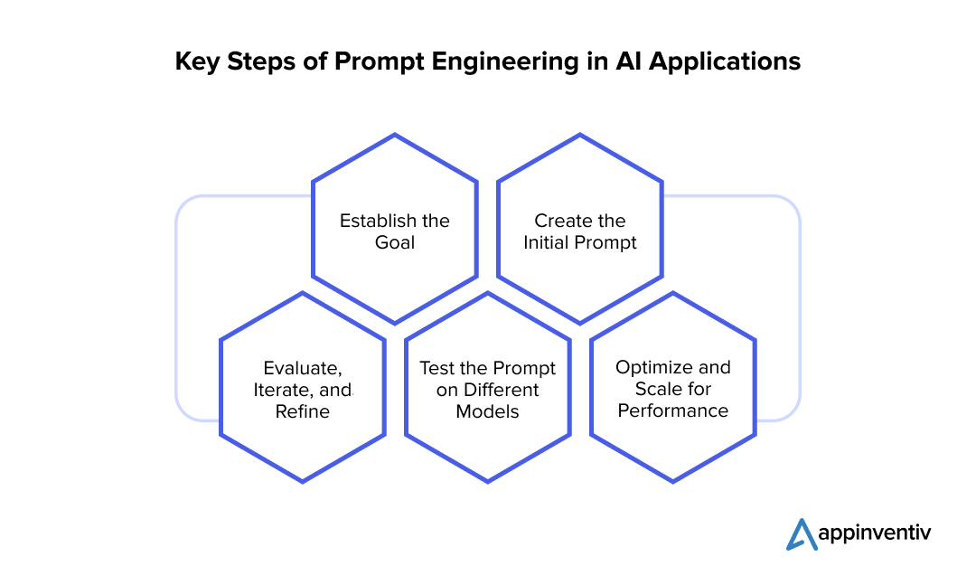

Slide 7


Prompt Optimization and Continuous Refinement
Evaluate Responses
1
Thoroughly assess the model's outputs to pinpoint opportunities for enhancement.
Modify Prompts
2
Fine-tune the prompts by incorporating feedback and testing various approaches.
Track Effectiveness
3
Measure the revised prompts using relevant metrics to determine their success and impact.

Slide 8
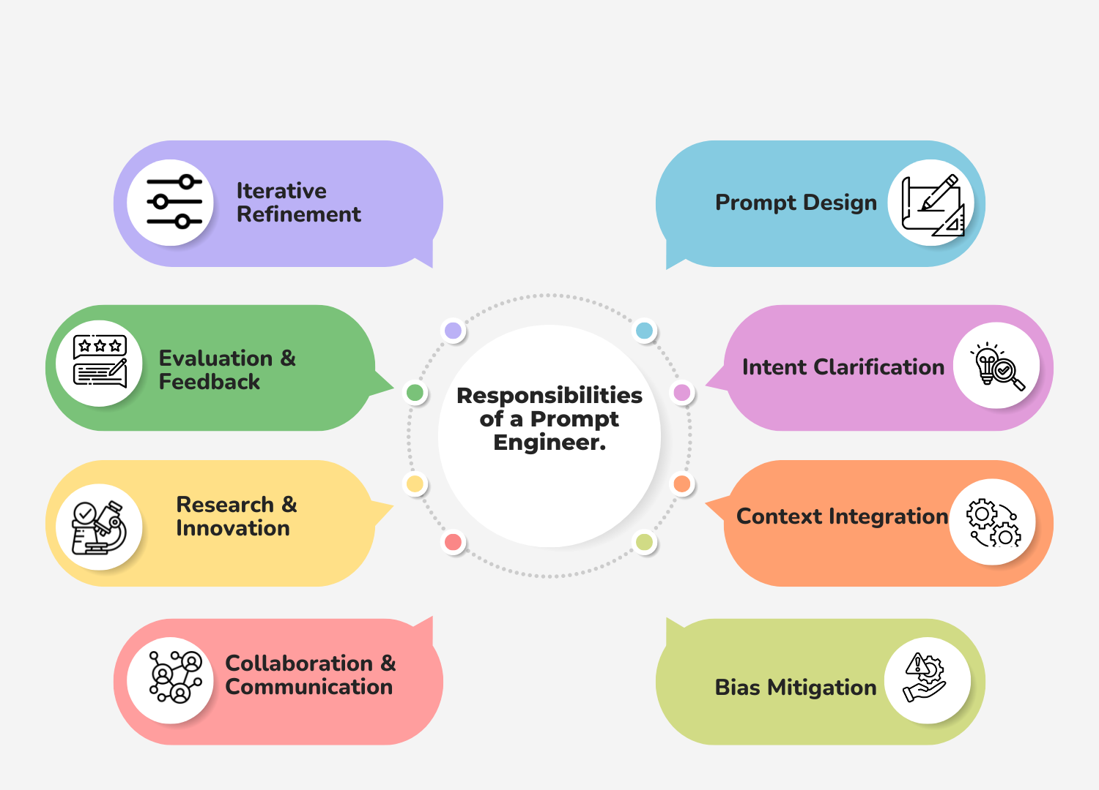

Slide 9
Ethical Guidelines
FAIRNESS
Guarantee that the content produced by prompts is fair, unbiased, and promotes inclusivity.
TRANSPARENCY
Maintain transparency about the role of language models and the use of prompts in generating content.
PRIVACY
Safeguard user data and uphold privacy standards during prompt-driven interactions.
SAFETY
Ensure that prompts do not lead to harmful, unsafe, or unethical outcomes.

Slide 10





Applications
CHATBOTS AND
VIRTUAL ASSISTANTS
CHATGPT
GEMINI
Prompt engineering enables the development of natural and engaging conversational AI experiences.
ChatGPT is a language model that uses machine learning to process and analyze large amounts of data to generate responses
Gemini is Google's AI model that can understand and respond to a variety of inputs, including text, images, video, and code.

Slide 11

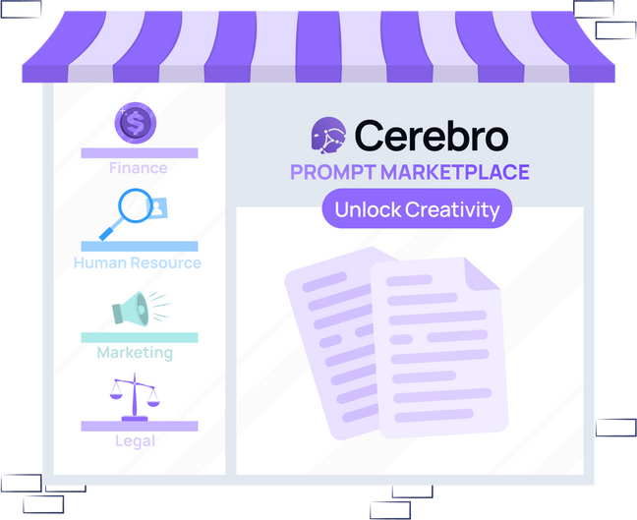
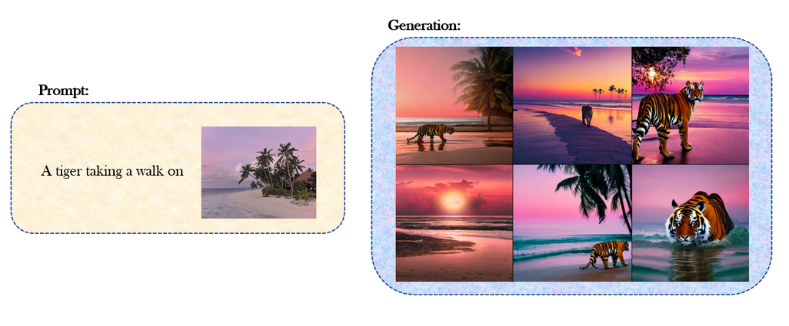

FUTURE OF PROMPT ENGINEERING
PROMPT MARKETPLACES
MULTI-MODAL PROMPTING
ETHICAL SAFEGUARDS
The rise of platforms where pre-designed, highly effective prompts can be shared, bought, and sold for various use cases.
Combining text, images, and voice inputs to create more versatile and rich prompts that enhance user experience
Continued emphasis on developing frameworks to ensure prompts generate safe, fair, and unbiased outputs.

Slide 12
CONCLUSIONPage
As we have explored, prompt engineering is a powerful technique for unlocking the full potential of language models. By crafting effective prompts, we can guide these models to produce high-quality, tailored content that meets our specific needs.

